Slide 1
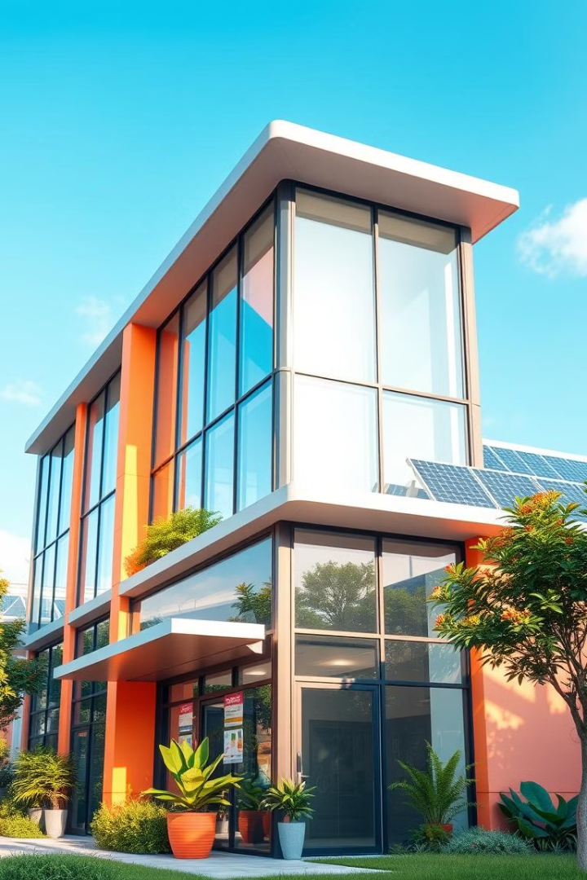
Predicting Building Energy Efficiency
Welcome to our Datathon project, where we delve into the complex world of building energy efficiency. Our team aims to develop predictive models that can help optimize energy consumption and minimize environmental impact.
By, Gnanendra Naidu N and Aditya Ranjan

Slide 2
Problem Statement: Energy Efficiency Prediction
Predicting energy efficiency ratings is crucial for identifying areas for improvement in building design and operations.
By accurately predicting energy consumption, we can identify inefficiencies and recommend strategies for reducing operational costs.
This project is essential in contributing to a more sustainable future by minimizing the environmental impact of buildings.

Slide 3
Data Collection and Preprocessing
We gathered a comprehensive dataset encompassing building characteristics, energy consumption data, weather patterns, and other relevant factors.
Data cleaning and preprocessing steps included handling missing values, transforming data types, and scaling features to ensure model robustness.
We carefully reviewed and validated the data to ensure its accuracy and completeness, crucial for building reliable predictive models.

Slide 4
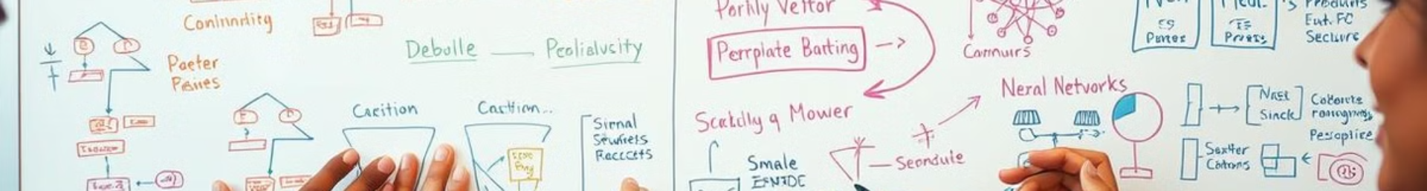
Initial Thoughts: Exploring Multiple Models
Use multiple model and find the best with respect to mean square error:
LinearRegression()
Ridge()
Lasso()
ElasticNet()
DecisionTreeRegressor()
RandomForestRegressor()
SVR()
KNeighborsRegressor()
MLPClassifier()
LinearDiscriminantAnalysis() Being the one of the best among the others
QuadraticDiscriminantAnalysis()
RidgeClassifier()
KNearest Neighbors classifier() Being the one of the best among the others

Slide 5




Model Training and Evaluation
Model Training
Model Evaluation
Model Selection
Wdataset into training and validation sets, allowing us to train the model effectively and assess its generalization ability.
We evaluated the model's performance using metrics like accuracy, precision, recall, and mean square error to understand its strengths and limitations.
Based on the evaluation results, we selected the best-performing model, considering both accuracy and interpretability.

Slide 6
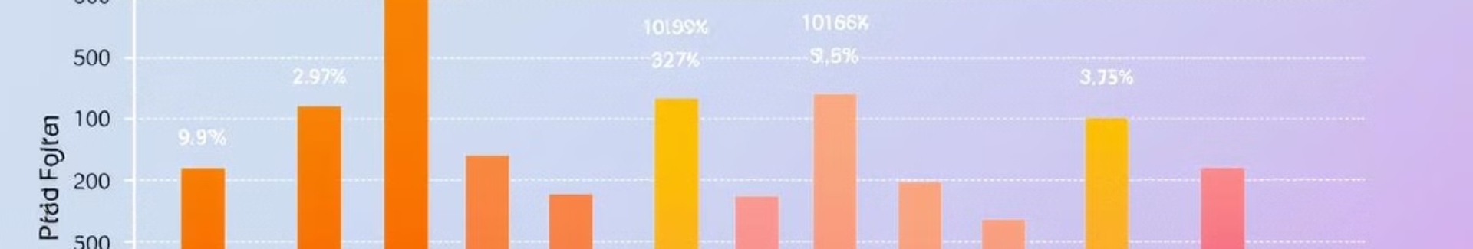
Identifying Inefficiencies and Opportunities
We presented recommendations for implementing cost-effective energy-saving measures, leading to significant reductions in operational costs.
We analyzed the model's predictions to identify buildings with high energy consumption and understand the contributing factors.
1
2
3
we use llama3.2 1B model to analyse the results generated by the model and then generated the improvements and suggestions

Slide 7
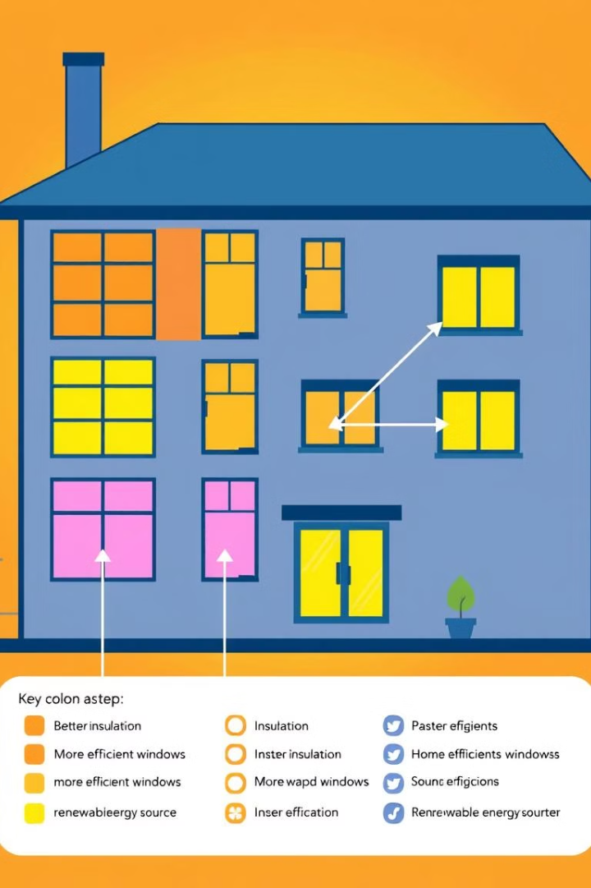



Key Insights and Recommendations
Building Envelope
Improving insulation in walls, roofs, and windows can significantly reduce heat loss and improve energy efficiency.
HVAC Systems
Optimizing HVAC systems by implementing smart controls, regular maintenance, and upgrading to energy-efficient models can lead to significant energy savings.
Renewable Energy
Installing solar panels, wind turbines, or geothermal systems can significantly reduce reliance on fossil fuels and minimize environmental impact.

Slide 8

Conclusion and Next Steps
Our Dataverse project has successfully developed predictive models for energy efficiency, providing valuable insights and recommendations for optimizing building performance.

